Slide 1
Advancing Network Security Research
Detection
DNS
Counter Measures
Yin Minn Pa Pa
1TC5501B
3rd August,2012(Friday)
11:30AM-1:00PM

Slide 2
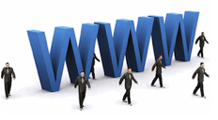
Scope of Studies
2
DNS
As an attacker :
Have challenge to build Flexible and Reliable Server Infrastructure
As a security researcher:
Why not think DNS as launch pad for Detection and Counter Measure against malicious activities.
DNS server problems in Myanmar
DNS is extensively used by today’s internet application
( The most in touch protocol to end users)
World Wide Distributed Databases
(Robustness)
Notes:
Why all the studies are relating to DNS .?
because of work experience ,notice that DNS servers that we are using are not reliable. Want to understand more on what’s going on ?
As an attacker, he or she has challenges like us to build flexible and reliable server infrastructure . They use DNS because of the two features below (1 and 2 ) bots resolve DNS
names to locate their command and control servers, and
spam mails contain URLs that link to domains that resolve
to scam servers
As a security researcher, why not we think DNS as a launch pad ? Can we use DNS for monitoring , detection and taking action on DNS based malicious activities? These questions make me to study (1) Zone transfer and (2) DNS analysis
Internet miscreants have been leveraging
the DNS to build malicious network infrastructures for
malware command and control.

Slide 3
Scope of Studies
2
DNS based Network Security
Misconfiguration on
Zone Transfer
DNS traffic
Analysis
Counter
measure
DNS Based
Dynamic Monitoring System
DNS Based
Firewall System
SLD
Investigation
TLD
Investigation
Detection of Malicious Activities
Notes:
Explain overview of Current Studies ( Finished /Ongoing / Future)
Explain overview of future Studies
Will connect to next slide ->To explain why all my studies are relating to DNS ?
Current studies are more on “Detection “
Future studies for “ Countermeasures” and “ Security Monitoring “ “DNS firewall “ ???

Slide 4
Contents
1
Self Introduction
2
Scope of Studies
3
Current Studies
4
Future Studies
5
Expected Contributions from future studies
6
References
Notes:
This will be the contents

Slide 5
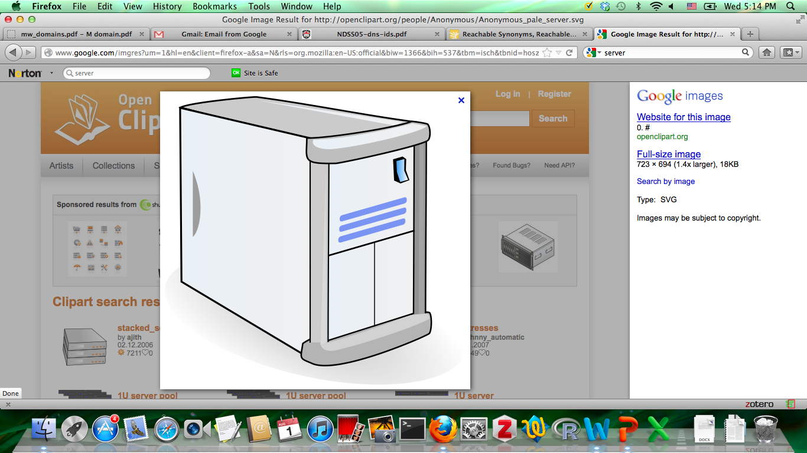
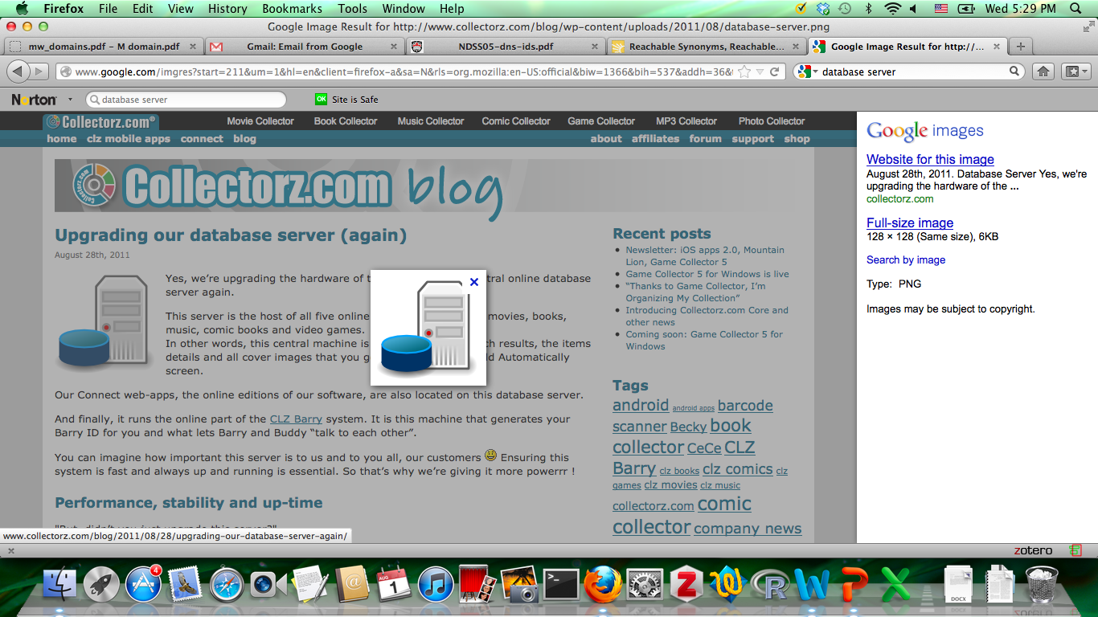

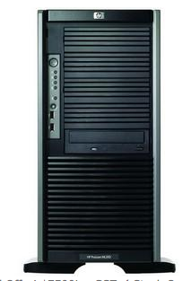
DNS Infrastructure
Internet
Open
DNS
Corporate
Network
root-level
U
Root
DNS
Cache
DNS
2
Top-level
1
Master
Slave
Zone
Transfer
3
Authoritative DNS
Slave
Users
4
Second-level
Master
Slave
Open
DNS
Notes:
In this slide , I will present
1.different types of DNS servers
2.Name resolving Process
3.Zone transfer

Slide 6

Overview of Zone Transfer
example2.com
Master
Slave
example1.com

Slide 7
Current Studies(Investigation on zone transfer )
3
Search engine based Investigation on misconfiguration of zone transfer in name servers authoritative to answer for TLD and SLD
Related Study
Our Study
Have Legal Issues
Legal Issues free approach
At Most two domains
Wider Scope of Investigation
Related Studies ( Downloaded Approach)
A.J. Kalafut [1] -> .com/.net
Wanrooijet al.[2]->.nl
The Measurement Factory [3]-> 3.22% of
. com and .net zones
Hierarchical Investigation

Slide 8
Motivations
Current Studies(Investigation on zone transfer )
3
When an organization does not use a public/private DNS mechanism to separate its external DNS information from its internal private DNS information, the organization is fully exposed to the Internet.
Resource Records (84 different information) can be leaked
Examples:
webmail0.zcu.cz. 86400 IN HINFO "PC-SERVER" ”LINUX-OS”
RouterBBR-4HG.kek.jp.3600 IN A 130.87.181.132
tanabemac3.kek.jp. 3600 IN A 130.87.76.149
t.ipmu.jp. 3600 IN TXT "google-site-verification=VLeiAE4TOL9j4jsf_lnu4ltSsjPqTZWeZ8-5sIASQ_8”
zonetransfer.me. 301 IN TXT "Remember to call or email Pippa on +44 123 4567890 or pippa@zonetransfer.me when making DNS changes”
dzc.zonetransfer.me. 7200 IN TXT "AbCdEfG"
testing.zonetransfer.me. 301 IN CNAME www.zonetransfer.me.
_sip._tcp.zonetransfer.me. 14000 IN SRV 0 0 5060 www.zonetransfer.me.
Notes:
The Google Site Verification API is intended for developers who want to write applications or services that automate the process of verifying ownership of a site or domain. This is important, since some Google services can only be used by website or domain owners. You can use the Google Site Verification API to validate that the authenticated user is an owner of the domain or site, possibly as the first step in programmatically provisioning other Google services.
GMail or Google Apps to handle their email
Testing web sites are less secure and can be attack vector
Session Initiation Protocol (SIP) 0 0 5060 ( priority/Weight /Open port )
Do I need to omit domains ?

Slide 9
Data Collection
Current Studies(Investigation on zone transfer )
3
According to IANA(Internet Assigned Number Authority)
ccTLD -> 249
gTLD -> 22
IDN -> 4
By the result of scripts (Net:DNS)
Total domains for the investigation -> 314
Authoritative Name Servers for 314 domains -> 1284
Google Site Search for SLDs
Sites of ccTLD (Multi Link Add-on) -> 156,648
Filtered Second Level domains -> 34,164
Authoritative Name Servers for 34,164 domains -> 46,416

Slide 10
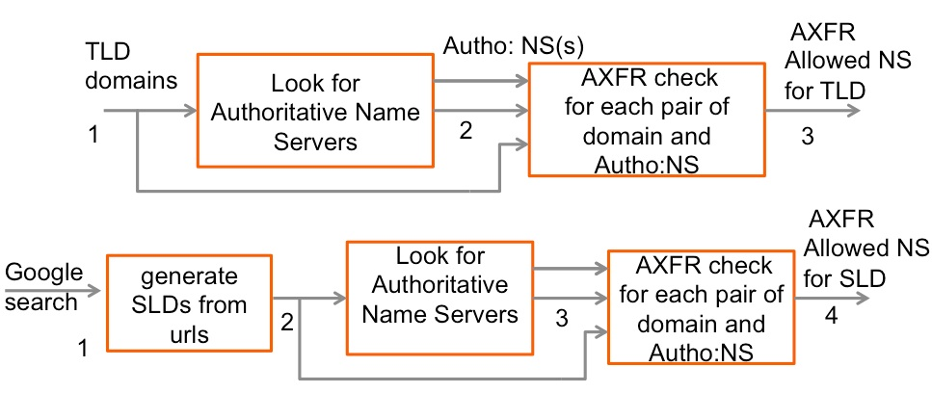
Current Studies(Investigation on zone transfer )
3
TLD investigation Steps
1.TLD list
2.Query NS
3.Query A
4.Query SOA
5.Authority Check
6.Check AXFR
Methodology
SLD Investigation Steps
1Google Approach
2.Generate SLD
3.Query NS
4.Query A
5.Query SOA
6.Authority Check
7.Check AXFR
Perl Net:DNS Modules

Slide 11
Current Studies(Investigation on zone transfer)
3
Results( Both TLD and SLD layers )
Level | Domains | Vulnerable | % | Name Servers | Misconfigure Name Server (by domain) | Misconfigure Name Server (by IP) | %
Top-level | 314 | 53 | 17 | 1,284 | 84 | 82 | 7
Second Level | 34,164 | 6,234 | 18 | 46,416 | 5,394 | 4,973 | 12

Slide 12
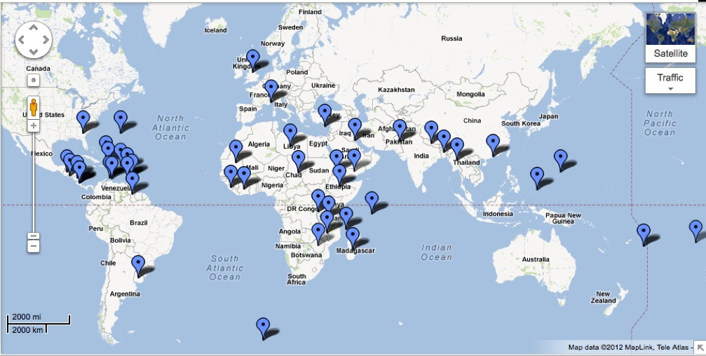
Current Studies(Investigation on zone transfer)
3
Results( Top-Layer -ccTLDs)
Top-level domains that allow zone transfer to anyone for their domains are:
[AERO. AN. AO. ARPA. AW. BB. BD. BI. BM. BV. CI. CR. CW. CY. DO. ER. ET. FO. GD. GE. GP. GQ. GT. GY. INT. IQ. KM. KW. MC. MG. ML. MO. MP. MW. NI. NP. PF. PG. PK. PW. SC. SJ. SL. SV. TC. TJ. TO. UK. VG. XN--FZC2C9E2C. XN--XKC2AL3HYE2A. XN--YGBI2AMMX. YE.]
( As of July 15 ,2012 )
9 top-level domains (.bv,.cs,.dd,.eh,.gb,.pw,.sj,.ss,.yn) are not currently in active.

Slide 13
Current Studies(Investigation on zone transfer)
3
Results( Second Layer-SLD)
Fig-Percentage of Misconfiguration
Fig-Location of Misconfigured DNS
bd
er
mm
( Fixed in June 22)
% of misconfiguration
ccTLDs
ck,fj,fk,gn,gt,jm,lr,sv) -> No Name Server for SLD
27 ccTLDs -> No Misconfiguration in both TLD & SLD
bd,er,mm -> Misconfiguration on both TLD & SLD

Slide 14


DNS Traffic and Malicious Online Activities
C&C
DDOS
Spam
Web
(Regular)
Corporate
Network

Slide 15
Current Studies( DNS traffic Analysis)
3
Main Objective
To characterize the signatures of DNS traffic of malicious activities
To identify the infected hosts with high probability
Related Study
Our Study
Notos: [4]
Dynamically assigns reputation scores to domains before maliciousness has not been detected
EXPOSURE: [5]
15 Features of malicious DNS activities
Detection of Malware domains
Kopis: [6]
Upper DNS Hierarchy traffic analysis
Detection of Malware domains
Host Based Analysis
Malicious DNS features from Sandbox DNS traffic

Slide 16
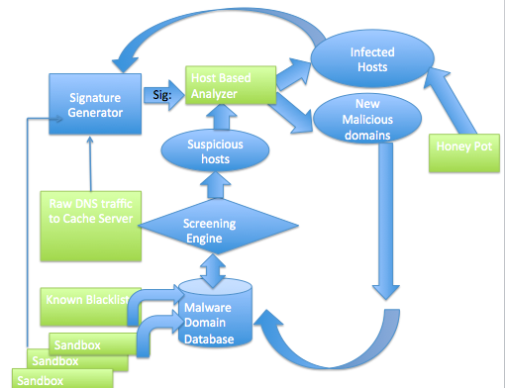
Current Studies(Analysis on DNS traffic)
3
Design
Screening
Matching with Known Blacklist
Behavioral Similarity
Host Based Analysis
Update Blacklist
Update Behaviors
Update Blacklists
Notes:
There will be three basic steps for the detection of malware infected hosts:
The first step will be the screening process for suspicious hosts by two methods. One is the matching of each DNS query and response with blacklisted domains and IP addresses. The other method focuses on detecting a set of hosts with behavioral similarity, such as bots.
As the second step, we will conduct a host based analysis for each DNS traffic from the suspicious hosts using behavioral signatures. As the result of the second step, we aim to obtain a list of infected hosts with high probability.
Finally, the third step provides a feed-back to the first and second steps. Namely, we will conduct updating of the blacklist and the behavioral signatures with the DNS traffic from infected hosts detected in the second step.
This analysis cycle will eventually provide us:
updated blacklists
updated behavioral signatures
updated list of infected hosts.
There are three types of inputs to the analysis cycle:
The first input is the known blacklists such as :
EXPOSURE blacklist domains(http://exposure.iseclab.org/malware_domains.txt
Malware Domain( http://www.malwaredomains.com/)
Zeus Tracker(https://zeustracker.abuse.ch/blocklist.php)
Malware Domain List (http://www.malwaredomainlist.com/)
The second input is malicious DNS traffic observed by long-term dynamic analysis of malware samples conducted by Japan side.
The third input is a list of infected hosts obtained by honeypot deployment.

Slide 17
Current Studies(Analysis on DNS traffic-Packet)
3
Results( Spybot)
Spybot DNS traffic
Nature of DGA -> Third Level domains pattern
Eg-
*.hn.org 147
*.afraid.org 148
*.yi.org 147
*.dynserv.com 148
A Queries for Mail/Web?
Week 1->(3091/130491 uniq A? queries)(DGA generated domains)
Week2 ->(2284/173237 uniq A? queries)new domains= 1430
Week 3 ->(24/190314 uniq A? queries ) new domains =10
Week 4 ->(31/137417 uniq A? queries )new domains= 8
Week 5 ->(19/148462 uniq A? queries ) new domains=1
Week 6 ->( 25/116968 uniq A? queries )no new domain
All unique domains for 6 week ( A Queries for Web)(not MX related)= 4609

Slide 18
Current Studies(Analysis on DNS traffic – Cache Log)
3
Results(Domestic University/Domestic Research Center)
Domestic University Log Data(29 to 1 July 2012 )
Found malware related domains = 41
Suspicious IPs = 255
(Matching with known malicious domains list )
Domestic Research Center Log Data( July 10, 2012 )
Found malware related domains=29
Suspicious IP = unknown IP information

Slide 19
Current Studies(Analysis on DNS traffic-Packet)
3
Project Overview ( Myanmar ISP’s DNS traffic)
Collaborative Research with Ministry of Communications, Posts and Telegraphs and Research Center for Information and Physical Security by Asia Pacific Telecom Fund provided to Myanmar.
Objectives
To identify malware infected hosts
To reduce the damage penetrated by malicious online activities
To improve quality of Services on Internet Security
Purpose
To deploy a monitoring system in Myanmar’s environment based on the research experience
To improve Human Resource Development
To get collaboration experience with a developed country

Slide 20
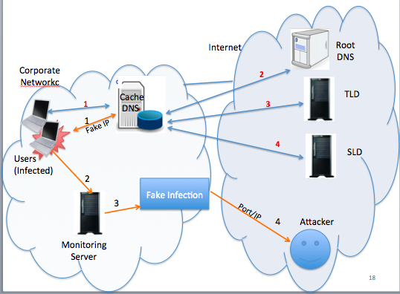
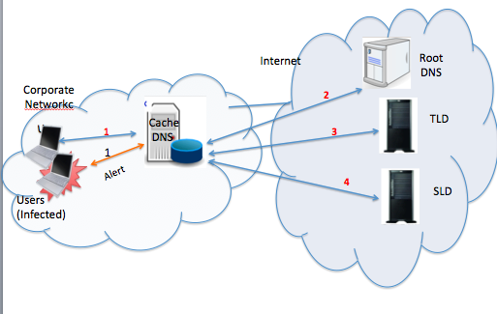
Future Studies
4
Developing Countermeasures for the infected hosts
Counter Measure Design 2
Counter Measure Design 1

Slide 21
Expected Contributions from Future Studies
5
Novel DNS based Counter Measure System
for the Infected Hosts
New DNS firewall for the cooperate Network

Slide 22
References
6
[1] A. J. Kalafut, C. A. Shue, and M. Gupta, “Touring DNS open houses for
trend and and configurations,” IEEE ACM Transactions on Networking, vol. 19, no. 6, p. 1666,
2011
[2] W. van Wanrooij and A. Pras, “DNS zones revisited,” in Open European
Summer School and IFIP WG6.4/6.6/6.9 Workshop (EUNICE), 2005
[3] The Measurement Factory, “DNS survey: October 2007,” http://dns.
measurement-factory.com/surveys/200710.html.
[4] M. Antonakakis, R. Perdisci, D. Dagon, W. Lee, and N. Feamster, “Building a dynamic reputation system for DNS,” in 19th Usenix Security Symposium, 2010.{NOTOS}
[5] S. Hao, N. Feamster, and R. Pandrani, “Monitoring the Initial DNS Behavior of Malicious
Domains,”2011”{EXPOSURE}
[6] M. Antonakakis, R. Perdisci, W. Lee, N. Vasiloglou II, and D. Dagon, “Detecting malware domains at the upper dns hierarchy,” in Proceedings of the 20th USENIX Security Symposium, USENIX Security, 2011, vol. 11, pp. 27–27.{Kopis}

Slide 23

Paper submission Plan to CSS2012 :
Title - Search Engine Based Investigation on Misconfiguration of Zone Transfer

